Slide 1
Machine Learning Working Group

Slide 2
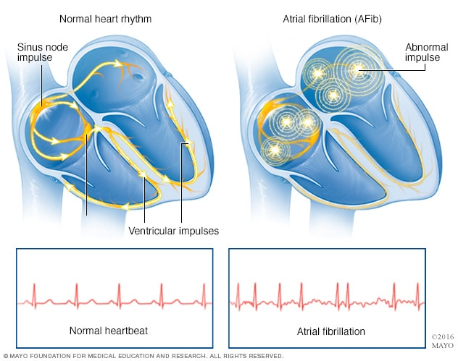
Purpose

Slide 3
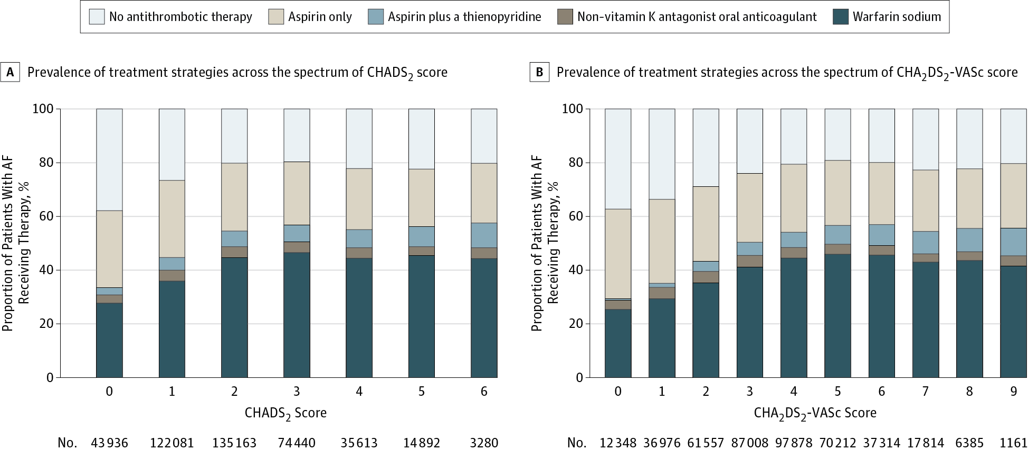
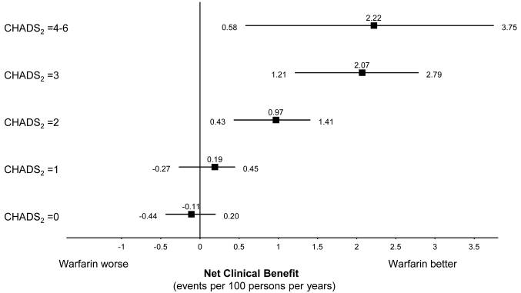
The cornerstone to preventing stroke in atrial fibrillation is identifying people at risk so that they can be started on anticoagulation
Ann Intern Med. 2009 Sep 1;151(5):297-305.
JAMA Cardiol. 2016 Apr 1;1(1):55-62
Notes:
SLIDE: illustrate the problem: Mike, is there a way to illustrate this – focusing on paragraph 2 of the specific aims/B.1. in the research strategy – I’m thinking of something like the next slide (but not necessarily the next slide…) At the bottom of the image we could state the 3 guiding hypotheses

Slide 4
 | Number with Atrial Fibrillation ICD code | Number without Atrial Fibrillation code
Total | 35,333 | 1,466,383
Men | 20,434 (57.8%) | 643,466 (43.9%)
Average age in years | 69.4 | 47.4
Race (% European, % African, % Other/Unknown) | 86.3% European American, 3.3% African American, 10.5% Other | 67.3% European, 6.2% African, 26.5% Other
% CHA2DS2-Vasc >= 2 | 26,030 (73.7%) | N/A
Prescribed anticoagulation within 1 month of first diagnosis | 9,262 (26.2%) | N/A
Data on UCHealth (obtained from Health Data Compass); note that only 26.2% of patients with a new AF diagnosis and moderate stroke risk were prescribed anticoagulation within 1 month of discharge

Slide 5
Goal
Develop a 6-month risk classifier for AF in UCHealth patients based on entire EHR

Slide 6
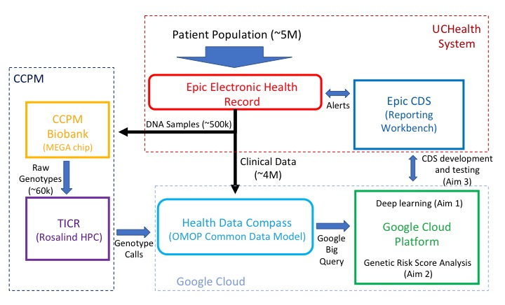

Slide 7
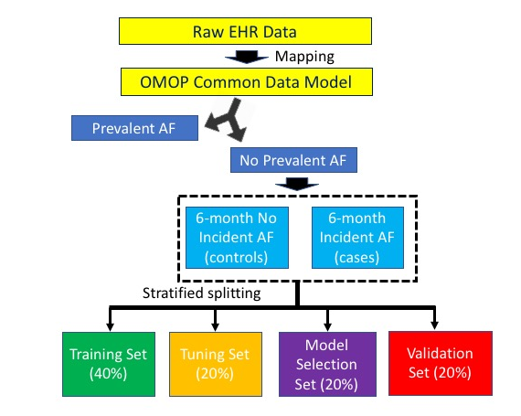

Slide 8

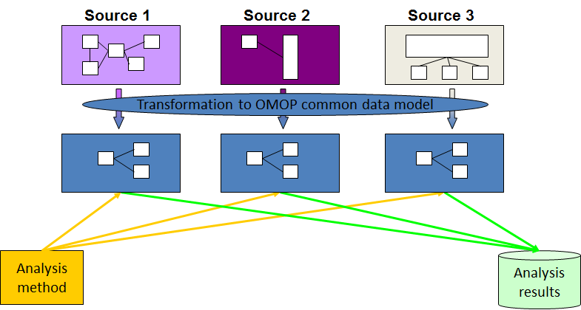
https://www.ohdsi.org

Slide 9
Analysis approach
UCHealth Data (OMOP CDM)
Data Reduction (Stacked Autoencoder, PCA)
Data Balancing?
ML Classifiers (GBM, SVM, RF, etc.)

Slide 10
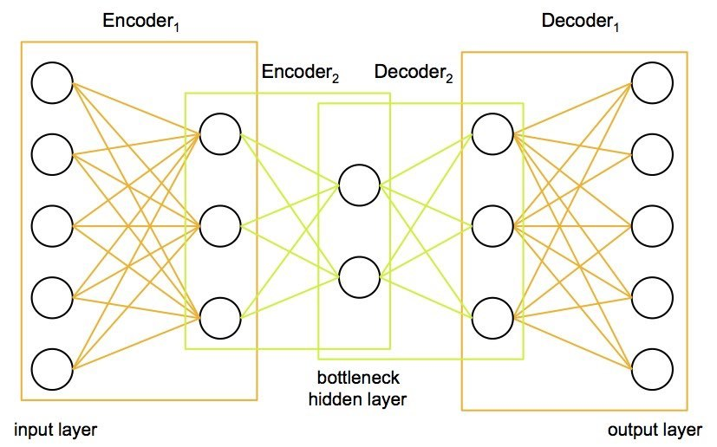
Stacked autoencoders

Slide 11
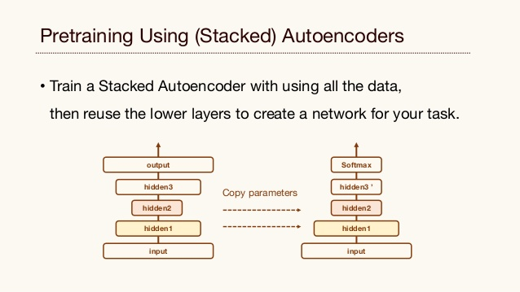
Stacked Autoencoders for pretraining

Slide 12
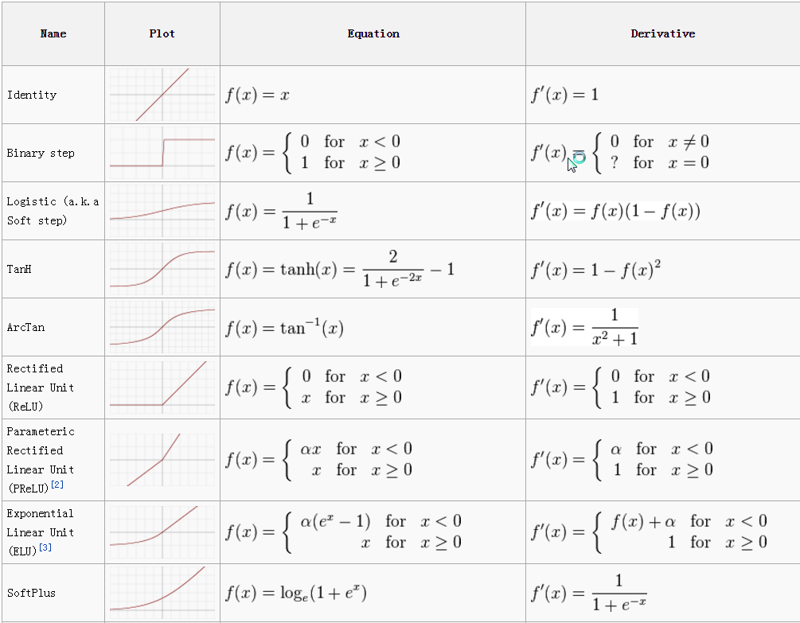
Activation functions

Slide 13
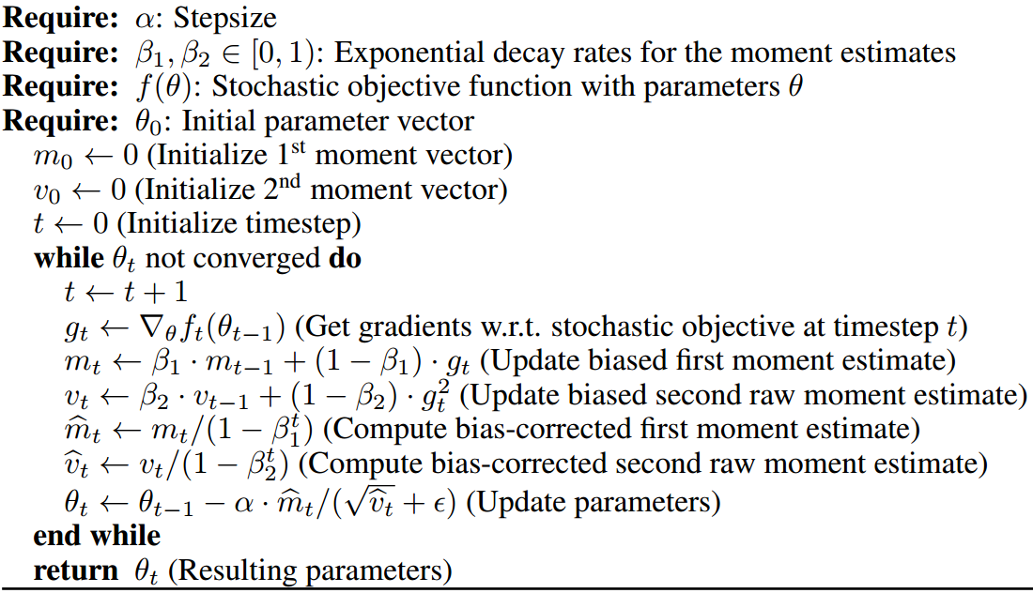
Adam optimization

Slide 14
Imbalanced data (imblearn)
Oversampling from minority class
Random with replacement
SMOTE
Synthetic Minority Oversampling Technique
ADASYN
Adaptive Synthetic
Undersampling from majority class
Cluster centroids
Random
Near Miss
https://imbalanced-learn.readthedocs.io/en/stable/introduction.html

Slide 15
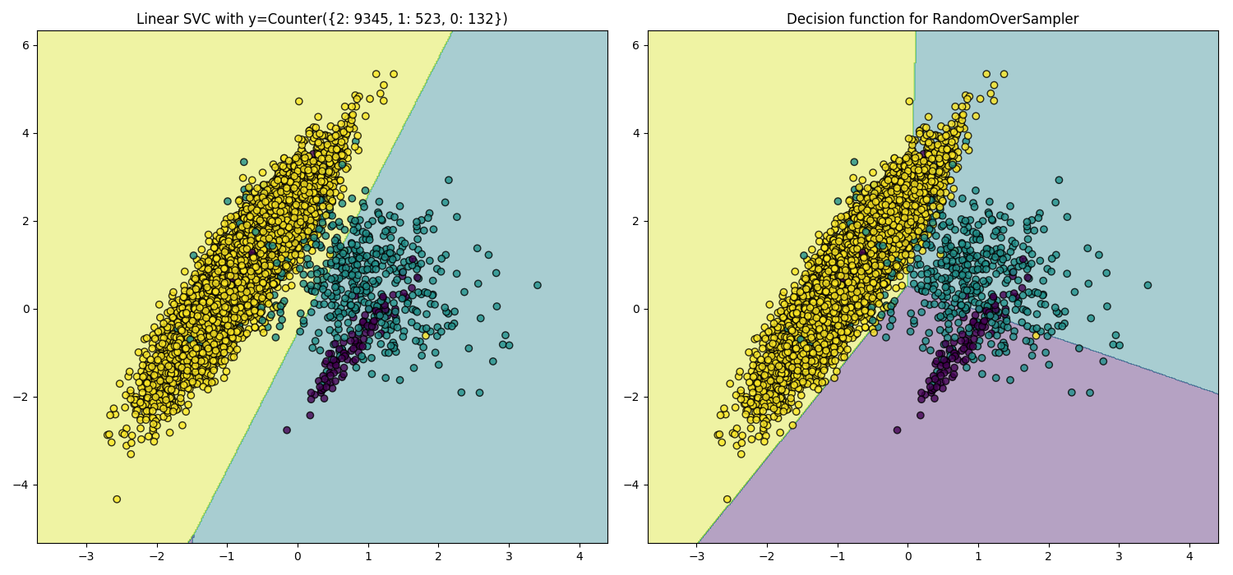
Oversampling

Slide 16
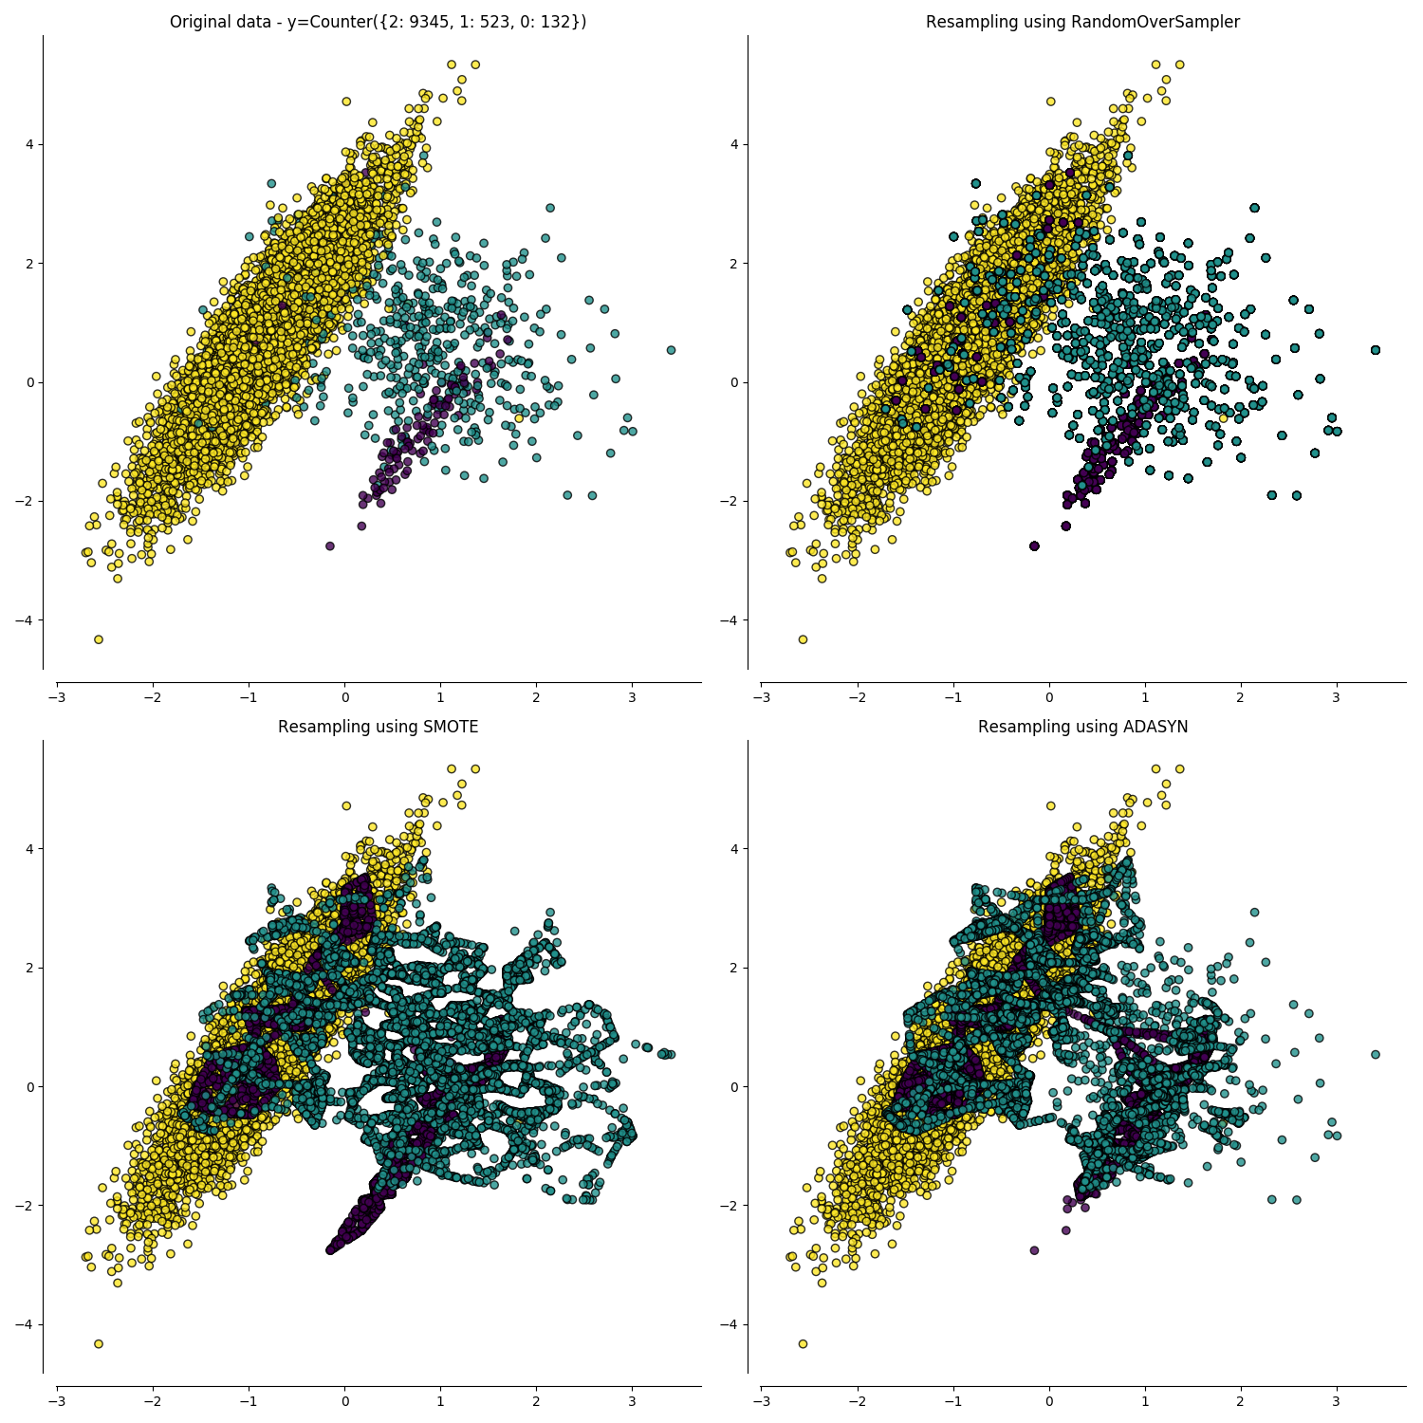
Imbalanced datasets: Oversampling

Slide 17
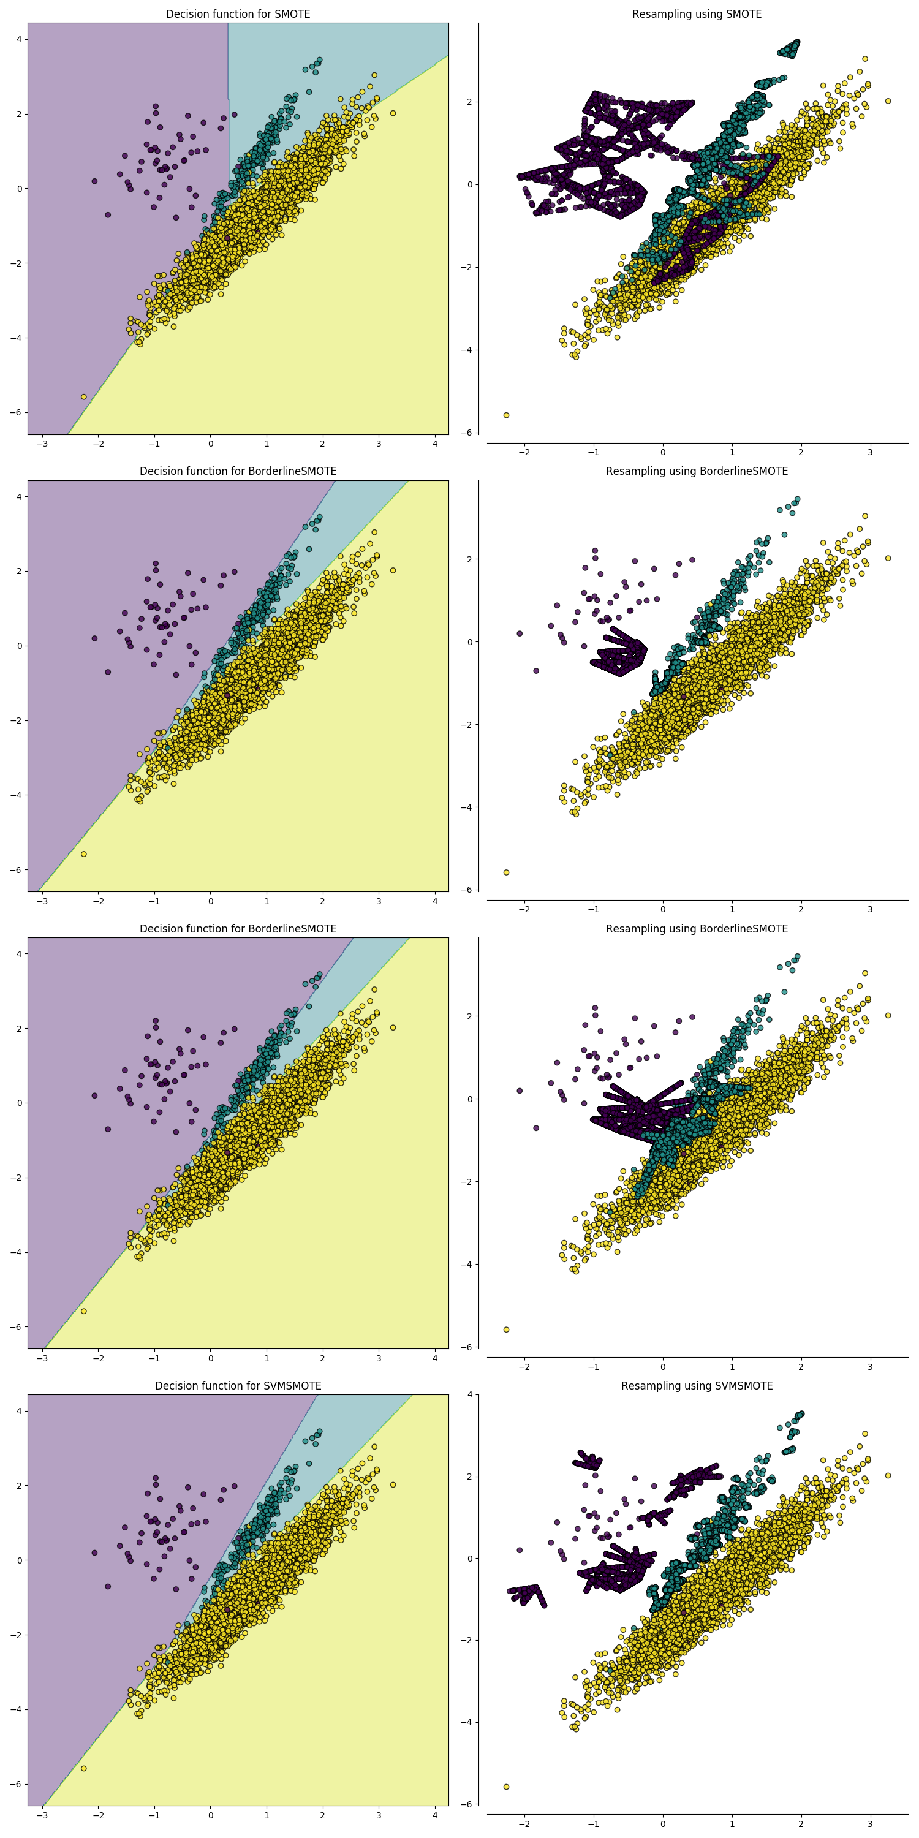

Slide 18
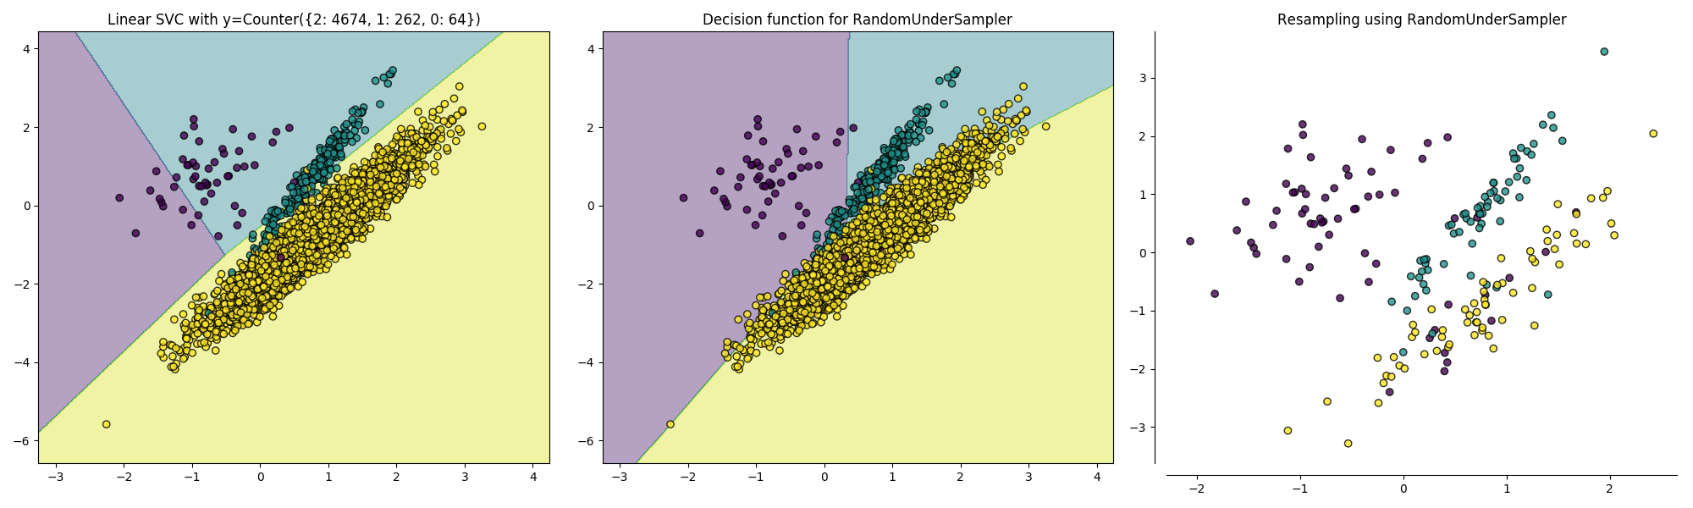
Undersampling

Slide 19
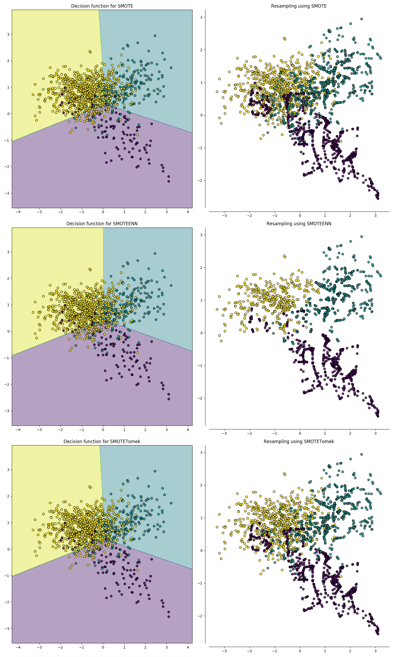
Combinations

Slide 20
Classifiers
Regularized regression
Boosted gradient descent (XGBClassifier, sklearn)
Random forest
Support Vector Machines (in the future…)

Slide 21
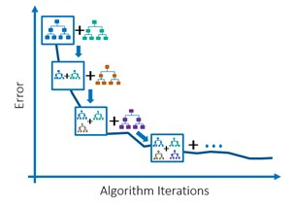
GB Classifier

Slide 22
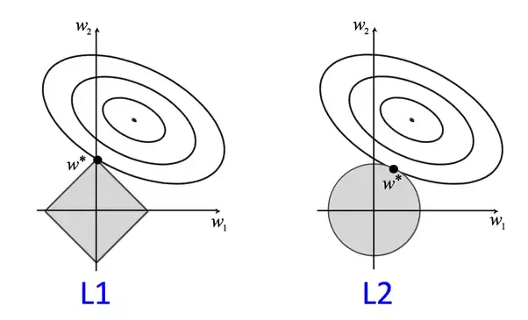
Normalized regression

Slide 23

Random Forest Classifier

Slide 24
Choosing the Best Model
Data splitting
Training set
Validation set (separate or within training set→ cross-validation)
Testing set
Identify the cost or loss function
Continuous Y → Square error, mean square error
Categorical Y → Cross-entropy/deviance
Goal is to find a model that predicts future data
Bias-Variance trade-off

Slide 25
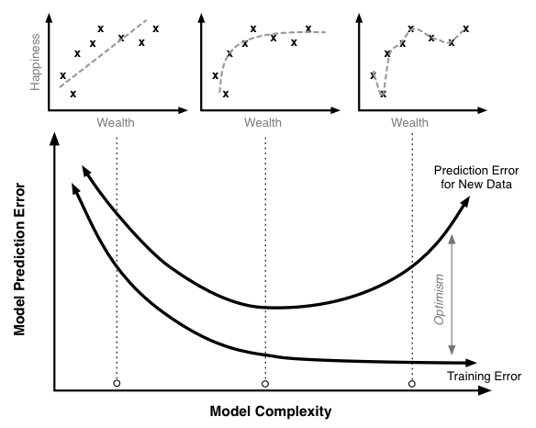
Need for Data Splitting

Slide 26
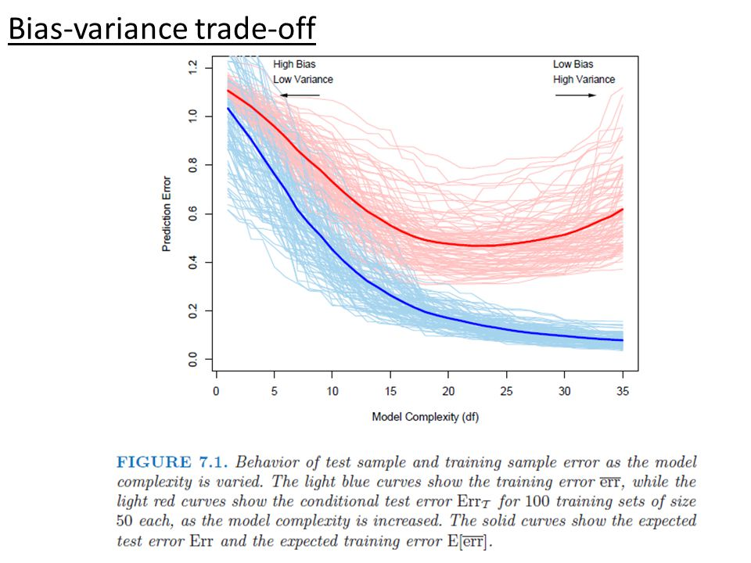
Bias-Variance Trade-off
Prediction Error ≈ [E(ŷ_{T}²) – E(y_{T})²] + [E(y) - E(ŷ_{T})]² + σ²
Variance
(aka, predictability)
Bias
(aka, fit)
Irreducible error
Complexity needed is based on complexity of underlying process generating y
Testing set
Training set

Slide 27
Classification Accuracy
Run several models and choose best based on error/loss value in test data
Examples: Cross-entropy/deviance, Accuracy, Misclassification rate
Classification models
Logistic regression
+/- shrinkage/regularization (i.e., lasso or ridge)
Trees
Bagged
Boosted
Random Forest
Support Vector Machines
K-nearest neighbors

Slide 28
Contingency Table (Confusion Matrix)
 | Disease Status
Model Prediction/Test |  | YES | NO
 | Positive | True Positive (TP) | False Negative (FN) | Total Predicted Positive
 | Negative | False Positive (FP) | True Negative (TN) | Total Predicted Negative
 |  | Total With Disease | Total Without Disease | Total

Slide 29
Classification Measurements
Sensitivity (Recall, True Positive Rate) = TP / TP + FN (Total with disease)
Specificity (True Negative Rate) = TN / TN + FP (Total without disease)
Positive predictive value (Precision) = TP / Total Predicted Positive
Negative predictive value = TN / Total Predicted Negative
False Positive Rate (Fall-out) = FP / Total Predicted Negative = 1 - TNR
False Negative Rate = FN / TP + FN (Total with disease) = 1 - TPR
False Discovery Rate = FP / Total predicted positive = 1 - PPV
Accuracy = TP + TN / Total
F1 score (harmonic mean of precision and recall) = 2*TP / (2*TP + FP + FN)

Slide 30
Classification Error
Cross-entropy loss (log loss)
= -(y log(p) + (1-y)log(1-p))
Deviance (goodness of fit)
= 2(log(p(y|Saturated Model)) – log(p(y|Reduced model))

Slide 31
Classification using KNN
K-nearest neighbors
Non-parametric
Assign to category of k nearest neighbors
k is inversely proportional to model complexity
Low k → More complex/flexible model, low bias, high variance
High k → Less complex, high bias, low variance

